Slide 1
Module 3 – From EER to Relational Schema
COMP 2714 – Relational Database Systems
Learning Outcome: LO2 – Apply techniques of database design including derivation of relational schema from EER models

Slide 2
Introduction

Slide 3
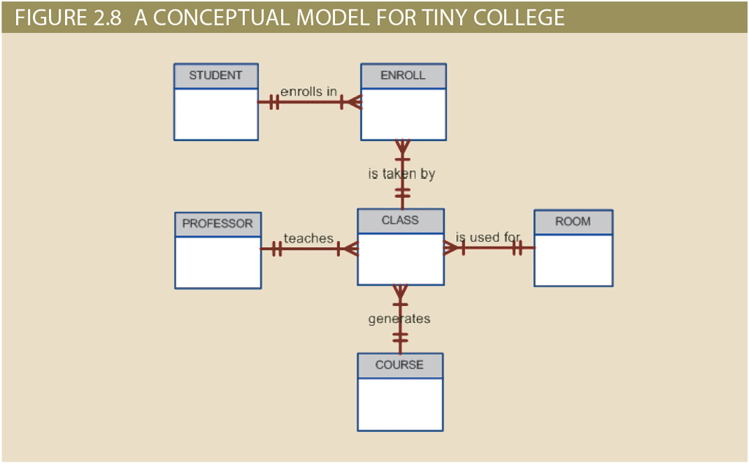
Business Rules
Business rules establish entities and the relationships between them.
ERD
Database Blueprint
?
But, ERD is not a Database Blueprint
We can not implement a relational database with ERD alone

Slide 4
The Relational Model
ERD provides a conceptual model of data
To implement a relational database we need an implementation-ready model.
Relational model is the implementation-ready model for relational databases
Implementation-ready model should contain at least 3 components
Description of data structures
set of enforceable rules to guarantee integrity
data manipulation methodology to support real life data transformations

Slide 5
Data Structures
Rows are entities
Columns are attributes
Relationships through common attributes
Rules
e.g.code can not be null
e.g code should be unique
Data Manipulation Methodology
SQL
AGENT Table
agent_code | agent_last_name | agent_first_name | agent_initial | agent_phone
CUSTOMER Table
customer_code | customer_last_name | customer_first_name | agent_code

Slide 6
Relational Model Basics

Slide 7
Entities → Tables
Rows & Columns
Each row represents a single entity
Each column represents an attribute
Each intersection of a row and column is a single data value
All values in a column have the same data format
Each column has a range of values known as the attribute domain
The order of rows and columns do not matter
Each table must have an attribute or combination of attributes that uniquely identifies each row → Primary Key

Slide 8
Primary Key
an identifier composed of one or more attributes that uniquely identifies a row.
A table often has more than one candidate for primary key
To ensure entity integrity, the value of all primary keys should be unique and none of the key attributes in the primary key should contain a null

Slide 9
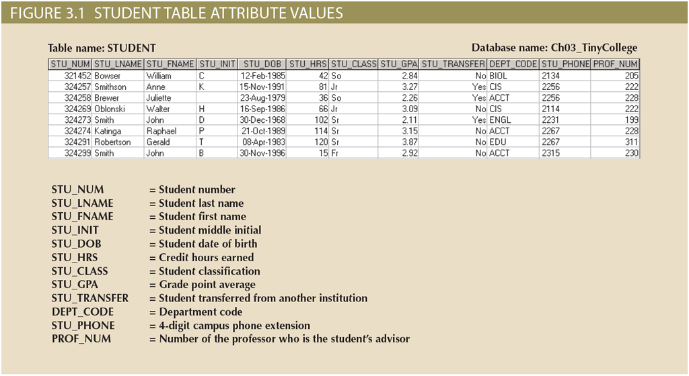
Example - STUDENT table

Slide 10
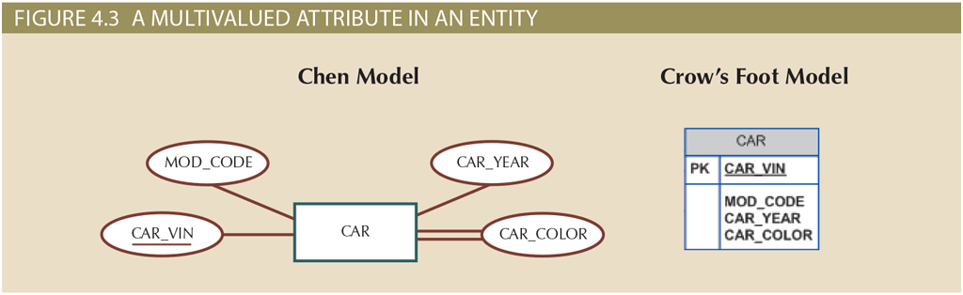
Modeling Multivalued Attributes
in ER modeling, attributes can be multi-valued
In the relational model, multi-valued attributes are not allowed
They must be transformed before implementation
(Details → Module 3: Mapping ER → Relational Schema)
For now: just recognize them in ERDs and know they will require special handling
Multivalued Attribute

Slide 11

How should we implement multivalued attributes?

Slide 12
Implementing Multivalued Attributes
Cannot be directly implemented into an RDBMS
Two ways to implement:
Create several attributes
Only use if all entities have the same number of values for the multivalued attribute and no instance ever has more → otherwise would lead to nulls and is not an acceptable solution
New entity to keep attribute’s components
Preferred solution → flexible & expandable

Slide 13
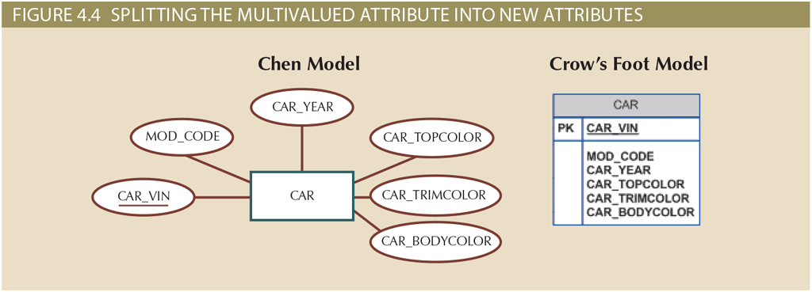
Implementing Multivalued Attributes
First Solution: Multiple Attributes

Slide 14
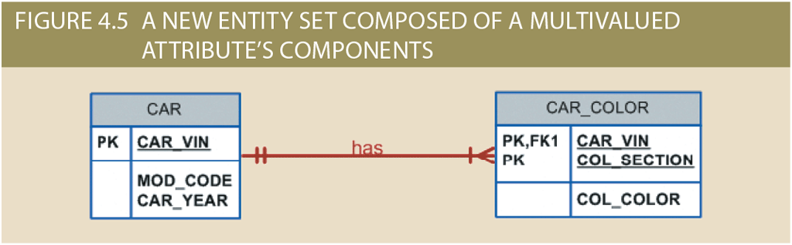
Implementing Multivalued Attributes
Second Solution: New Entity in 1:M relationship
Notes:
Section: Top, Body, Trim, Interior
Color: White, Blue, Gold, Blue

Slide 15
Business Rules
Business rules establish entities and the relationships between them.
ERD
Database Blueprint
Entities & Attributes → Tables
How do we implement the relationships?

Slide 16
Mapping Relationships

Slide 17
Relationships
One to Many
ideal
should be the norm in an relational database design
One to One
should be rare
Many to Many
cannot be implemented —> should be broken down into two 1:M relationships
1:M
1:1
M:N

Slide 18
1:M Relationship
implemented by putting the PK of the “1” side in the table of the “Many” side as a foreign key
foreign key: the primary key of one table placed in another table to create a common attribute

Slide 19
Referential Integrity
every reference to an entity instance by another entity instance is valid.
in other words, making sure that what we are linking to actually exists.
the FK should be either null or a valid value

Slide 20

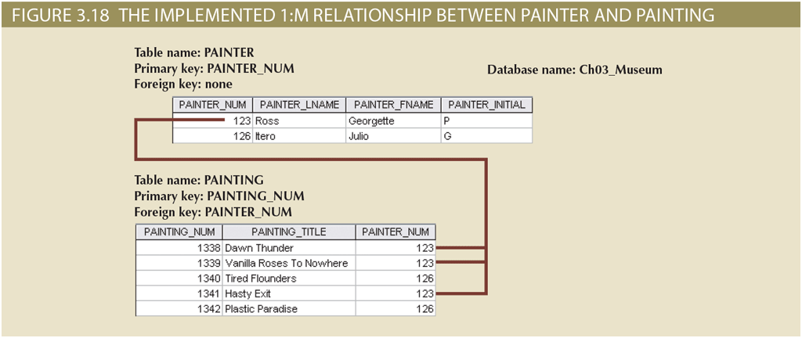
1:M Relationship

Slide 21
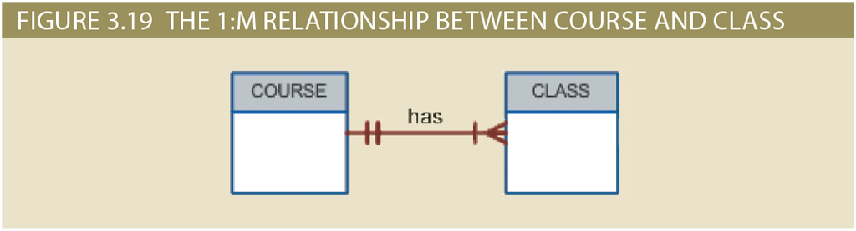
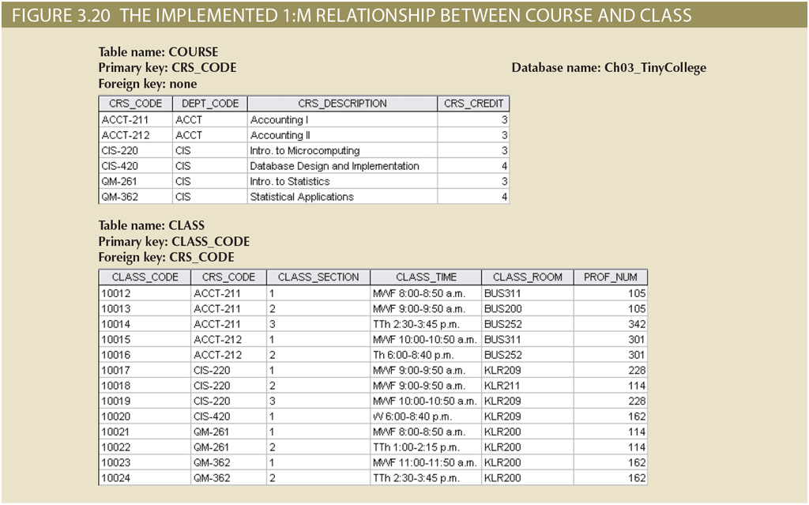
1:M Relationship

Slide 22
Implementing 1:1 Relationships
Placing a FK in both entities is not recommended as it duplicates work and might also interfere with other relationships between the two entity.
e.g. consider EMPLOYEE chairs DEPARTMENT (1:1) and EMPLOYEE works in a DEPARTMENT (1:M)
So we have to place the FK in one of the tables. But which one?

Slide 23
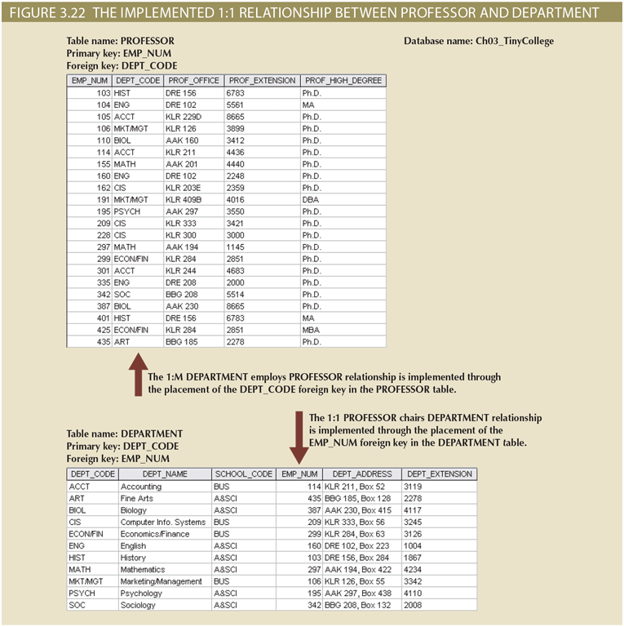
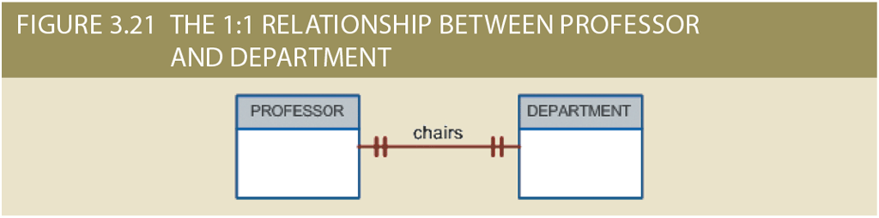
1:1 Relationship
We could potentially put the PK of DEPARTMENT into the PROFESSOR table. But that would be less ideal as not all professors are department heads (leads to lots of nulls). But each department has a head.
Notes:
Going back to this example. Compare the two designs in terms of number of nulls they create.

Slide 24
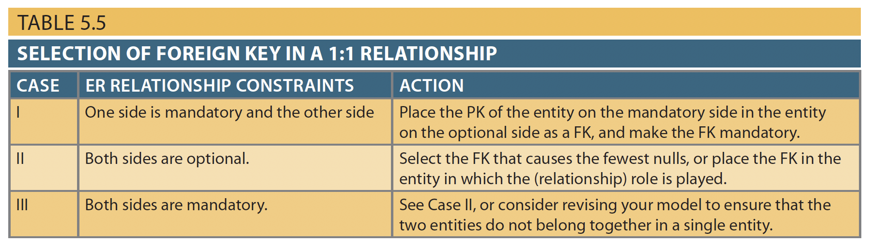
Null Values
nulls should be avoided as much as possible
abundance of nulls is a sign of poor design

Slide 25
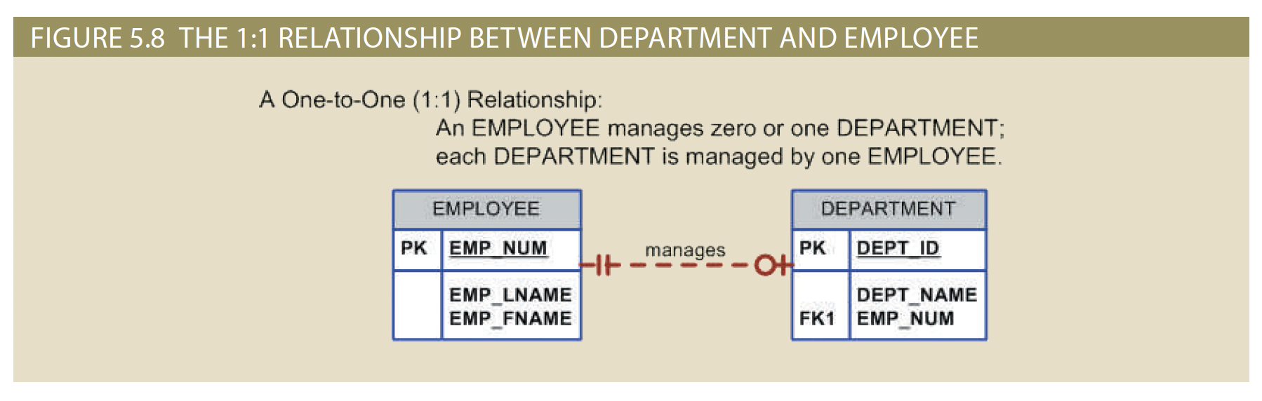
Implementing 1:1 Relationships
Example: One side is mandatory and the other side is optional.

Slide 26
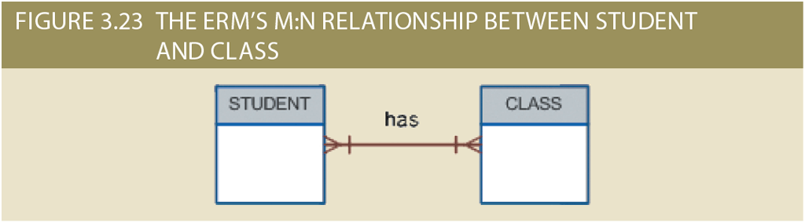
M:N Relationship
Relationships are implemented through common attributes.
Which common attributes should we defined among the two tables?
Notes:
Going back to this example. Compare the two designs in terms of number of nulls they create.

Slide 27
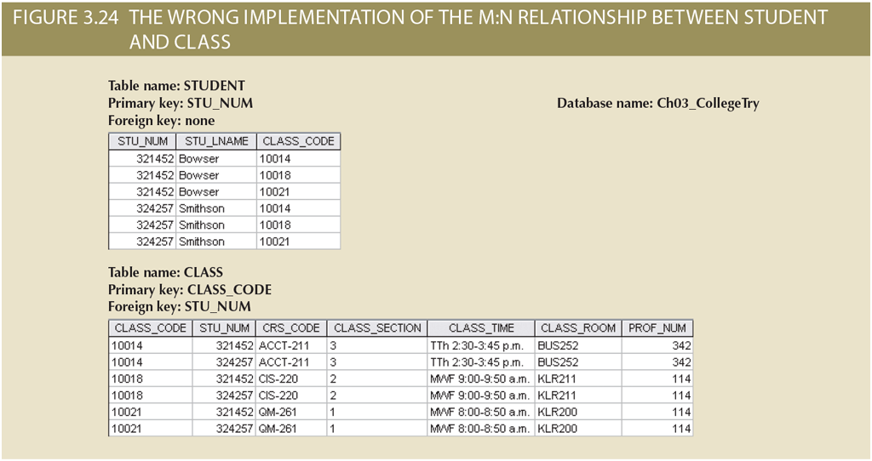
M:N Relationship
Design 1
the above implementation is not good
Many redundancies —> leads to Anomalies

Slide 28
M:N Relationship
Design 1
the above implementation is not good
Many redundancies —> leads to Anomalies
the relational operations become very complex —> leads to system efficiency errors and output errors
Changing the time of class 10018
one row for each student
as much as the number of students registered in the class, we have to do update operations

Slide 29
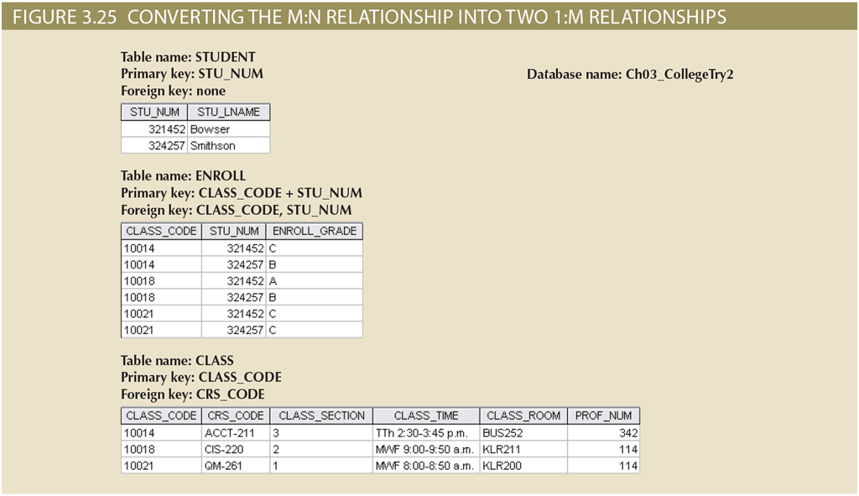
M:N Relationship
Design 2
The right way
create a composite entity
also called bridge entity or associative entity
includes the PK of the two tables that should be related
PK of the composite entity can be a composite key (combination of the two PKs) or the designer can introduce a new PK
the linking table can contain any relevant attribute
controlled redundancy in the ENROLL table will not lead to anomalies if the referential integrity is enforced

Slide 30
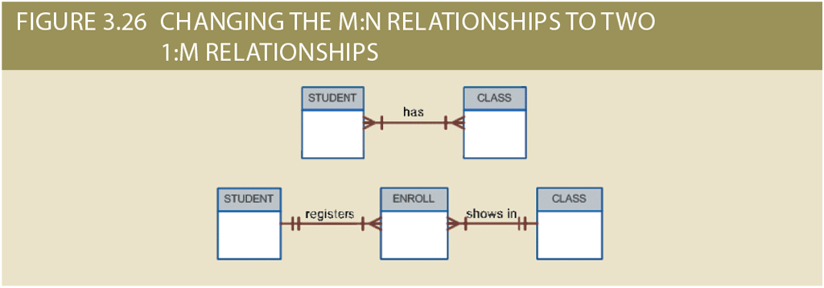

Slide 31
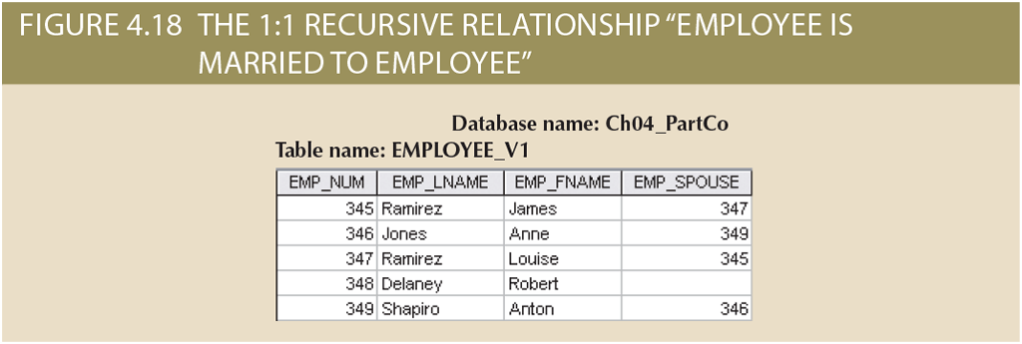
Implementing Recursive Relationships (1:1)
James is married to Louise, Louise is married to James (shared last name)
Anne is married to Anton, Anton is married to Anne (different last names)

Slide 32
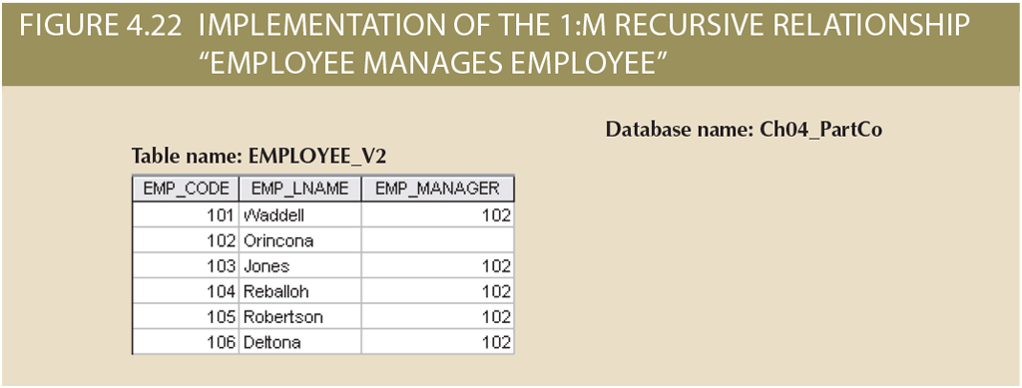
Implementing Recursive Relationships (1:M)

Slide 33
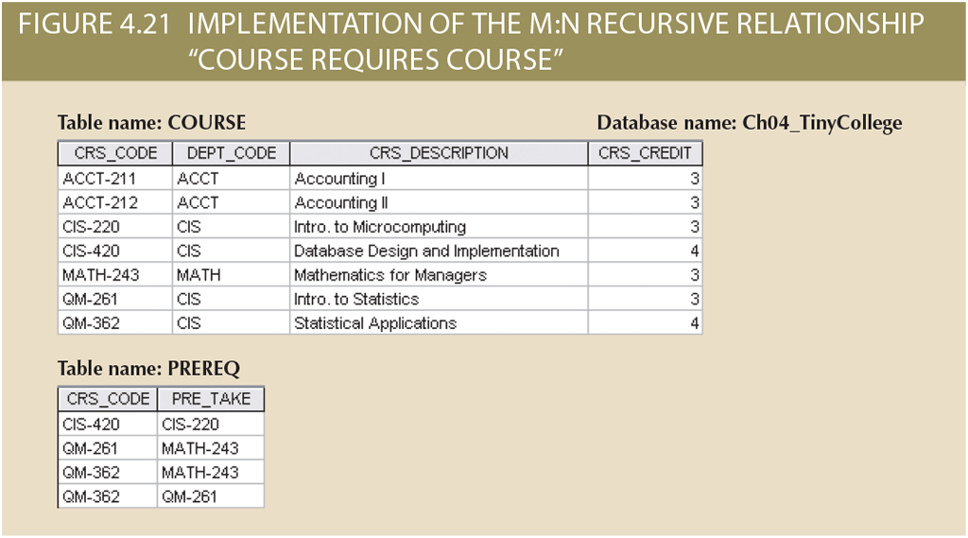
Implementing Recursive Relationships (M:N)

Slide 34
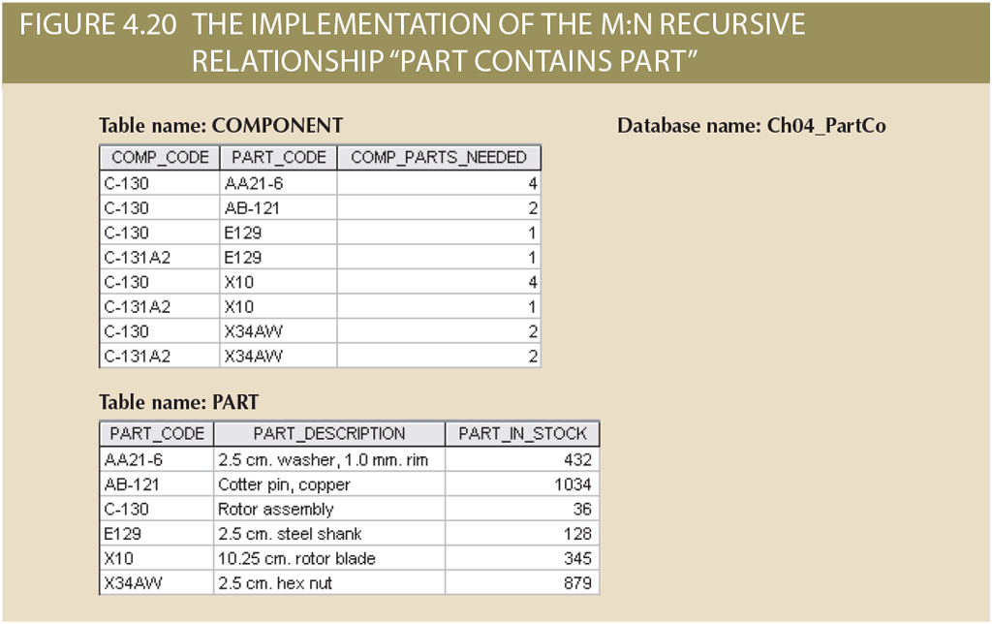
Implementing Recursive Relationships (M:N)
If PART consists of many PARTs and can be part of many, we need two tables
Part tracking is very common & important practice which is required by law for some industries, e.g. Aviation

Slide 35
Existence Dependence
Some entities, we should keep in the database, only if they are related to another entity in our system
Example: “EMPLOYEE Claims DEPENDENT”
If the employee is removed from the database, we clearly should remove his dependents from the database as well.
How do we implement existence dependence?

Slide 36
Implementing Existence Dependence
“An entity is existence-dependent if it has a mandatory foreign key -- that is, a foreign key attribute that cannot be null”

Slide 37
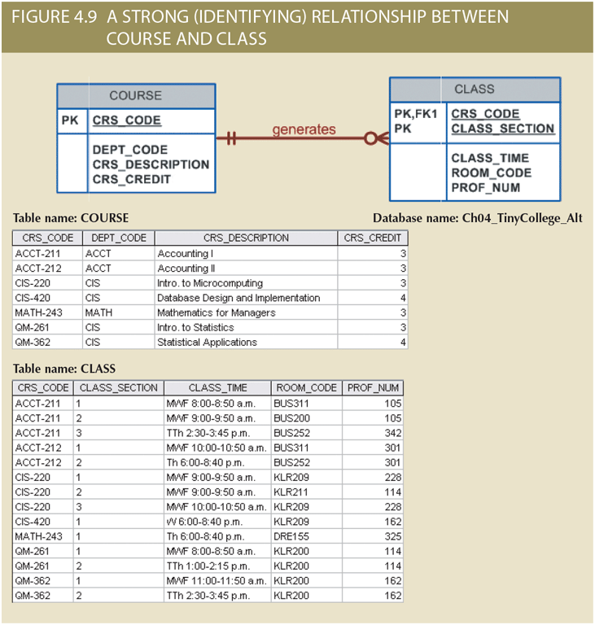
Implementing Strong Relationships
“The order in which tables are created and loaded is very important”
Usually the parent’s table should be created and loaded before the child entities.
Why

Slide 38
Implementing Specialization/Generalization Hierarchies
Goal: Map an EER supertype–subtype structure into relational schema.
Three common strategies:
Single Table (All in One Relation)
Multiple Tables (One per Subtype, No Supertype Table)
Supertype + Subtype Tables (Recommended)

Slide 39
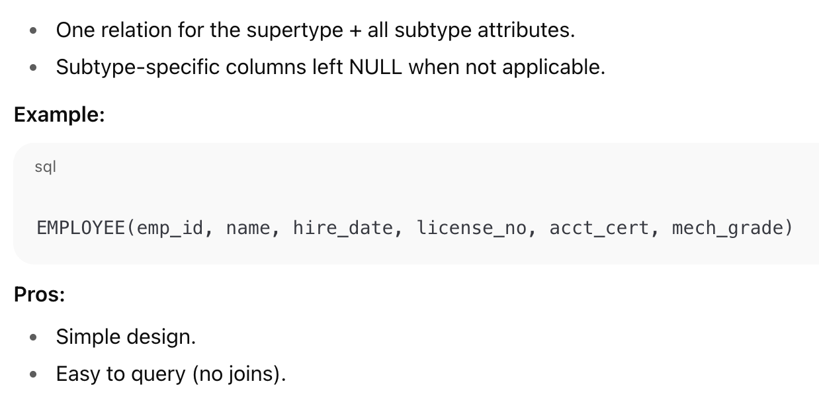
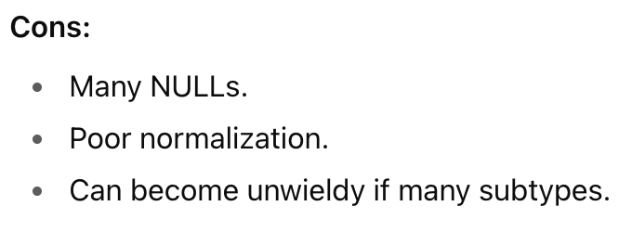
1. Single Table (All in One Relation)

Slide 40
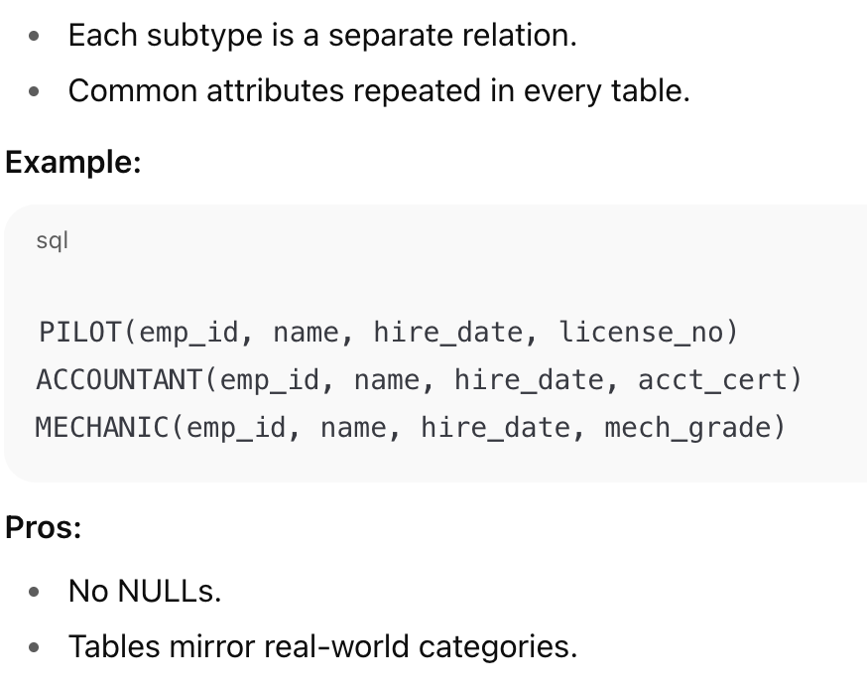
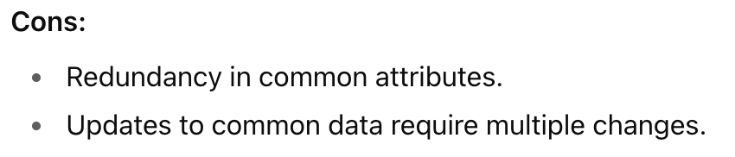
2. Multiple Tables (One per Subtype, No Supertype Table)

Slide 41
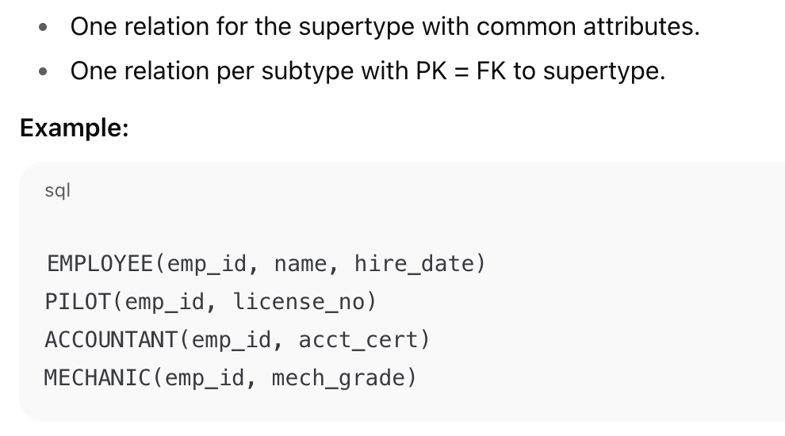
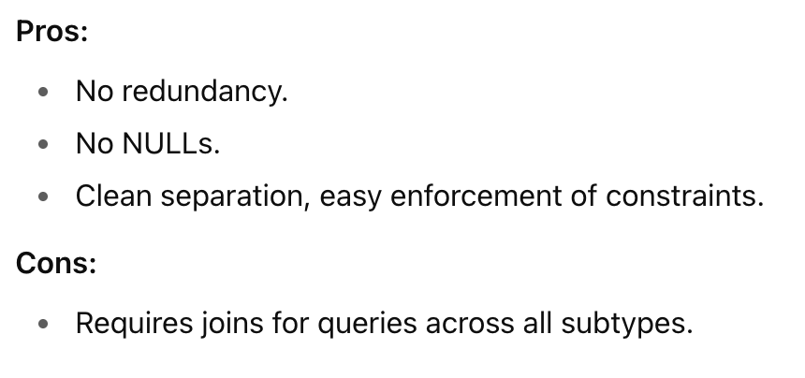
3. Supertype + Subtype Tables (Recommended)

Slide 42
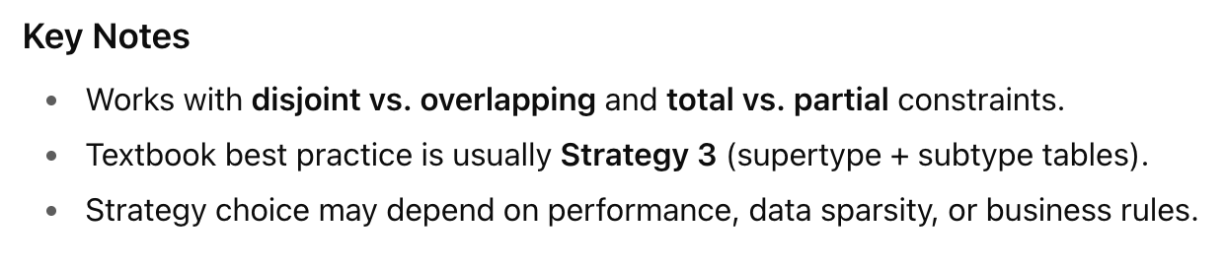
Implementing Specialization/Generalization Hierarchies
Goal: Map an EER supertype–subtype structure into relational schema.
Three common strategies:
Single Table (All in One Relation)
Multiple Tables (One per Subtype, No Supertype Table)
Supertype + Subtype Tables (Recommended)

Slide 43
Keys & Constraints

Slide 44
Selecting (Good) Primary Keys

Slide 45

Entity Integrity & Primary Key
The most important characteristic of an entity is its Primary Key
Remember that a primary key could be either a single attribute or a combination of multiple attributes
It is the PK that uniquely identifies every instance of an entity. (Every row of the table)
If you can’t uniquely identify the individual instances, then the entity doesn’t show entity integrity.
The efficiency and effectiveness of your DB is directly affected by your choice of primary keys.

Slide 46
Natural Keys & Primary Keys
In the real world, sometimes there are natural identifiers.
e.g. A car plate number
Natural keys are familiar to end users
If an entity has a natural identifier, use that as the primary key of the entity when you are modelling.
Most natural keys make acceptable primary keys but make sure that the natural key is also a good key.

Slide 47
What counts as a good primary key?!
How many attributes is too many attributes to have in a PK?
How long can a PK be?
Why do we choose EMP_NUM as PK and not a combination of EMP_LNAME, EMP_FNAME and EMP_DOB?
To answer questions, we need to understand a few things:
We have to distinguish between identification vs. description.
We have to consider the effect that the choice of PKs have on the implementation of relationships.

Slide 48
PKs are not to describe the entity. They are to be used to uniquely identify the entity, so that the value of other (descriptive) attributes can be quickly found.

Slide 49
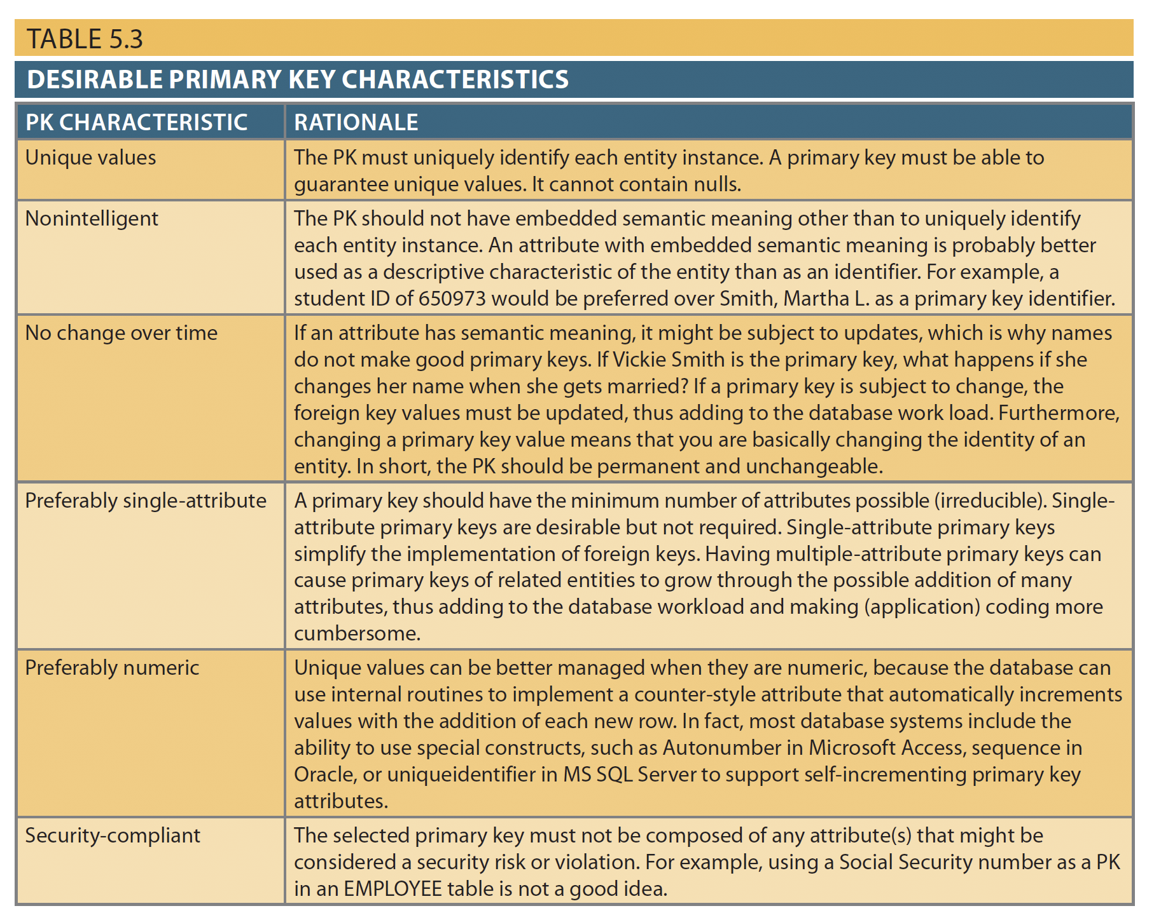
Desirable Primary Keys
Unique values
Non-intelligent
No change over time
Preferably single-attribute
Preferably numeric
Security-compliant

Slide 50
When to use composite primary keys?
When we say that we prefer PKs to be single-valued, that doesn’t mean composite primary keys are not allowed.
Composite keys are very useful as:
identifiers in composite entities. e.g. in ENROLL: a student cannot enrol more than once in the same class.
identifiers of weak entities.

Slide 51
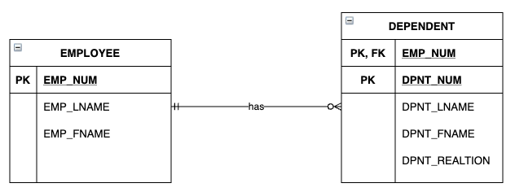
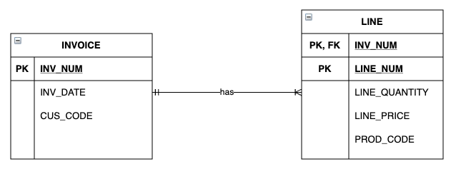
Composite PKs for Weak Entities
Remember that weak entities are usually used to represent one of the two situations below:
A real-world object that can only be in the database because of existence-dependence on another entity. Even though the two entities might be independent in the real-world.e.g. EMPLOYEE & DEPENDENT
When a real-world object is represented by multiple entities in our models. e.g. INVOICE & LINE
In both cases, using a composite primary key is a good choice as it ensures the weak entity has a strong identifying relationship to its parent entity.

Slide 52
When to use surrogate primary keys?
When we do not have a natural key, or the natural key doesn’t make an appropriate PK, we can use Surrogate Keys.
Surrogate Key (Also called Codes) are designed by the DB designer. To simplify identification of instances (not description).
Has no meaning in the user environment
DBMS can generate values (codes) for us. Since there doesn’t have to be any meaning.
Surrogate keys are accepted practice in today’s complex data environments.

Slide 53
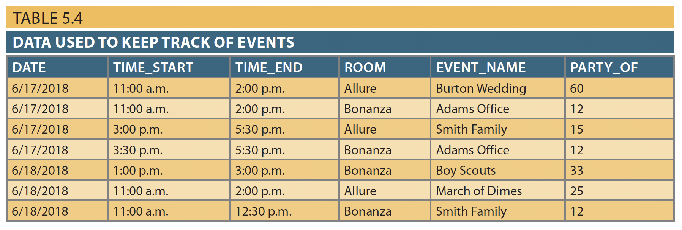
When to use surrogate primary keys?
Is there a good natural key?
Remember that if you choose multiple attributes for PK just because a single attribute natural key cannot be found, then you will complicate the implementation of relationships through FKs.

Slide 54
Complicating the implementation (of both database) and applications because of lengthy primary keys is unnecessary. Instead use a numeric, single-attribute surrogate key!

Slide 55
IMPORTANT: if you use a surrogate key, you still need to ensure that the candidate key of the entity in question performs properly through the use of “unique index” and “not null” constraints.

Slide 56
Constraints in Relational Schema
Constraints = rules that ensure data validity & consistency
Types:
Entity integrity (primary key: unique, non-null)
Referential integrity (foreign keys must match a valid value in parent relation)
Attribute constraints (e.g., NOT NULL, uniqueness, allowed values)
Constraints capture business rules beyond just structure

Slide 57
Entity & Referential Integrity
Entity integrity
Every relation must have a PK
PK must uniquely identify tuples
PK attributes cannot be NULL
Referential integrity
FK values must exist in the referenced relation
Prevents “orphan” records

Slide 58
Attribute & Business Rule Constraints
Attribute-level
NOT NULL: value required
Uniqueness: no duplicates allowed
Simple checks (e.g., grade ∈ {A,B,C,D,F})
Business rules (sometimes can be enforced as constraints)
Example: end_date ≥ start_date
In practice: constraints ensure your relational schema is both valid and faithful to requirements

Slide 59
Special Design Cases

Slide 60
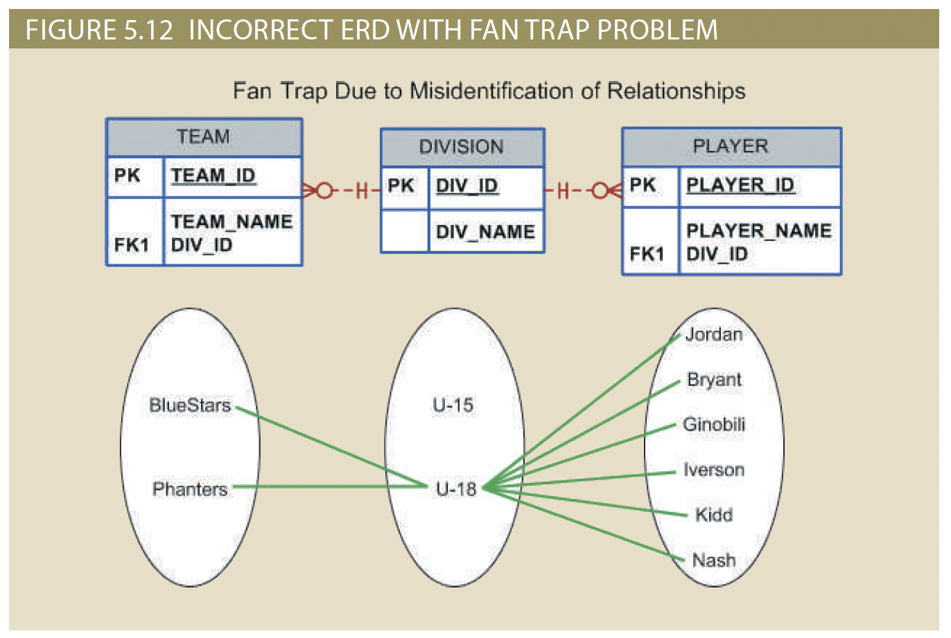
Fan Traps
The most common design trap
We should eliminate Fan traps as they are usually a sign of misidentified relationships.
E.g. Notice that even though everything is semantically correct, there is no way to find out which player plays in which team!

Slide 61
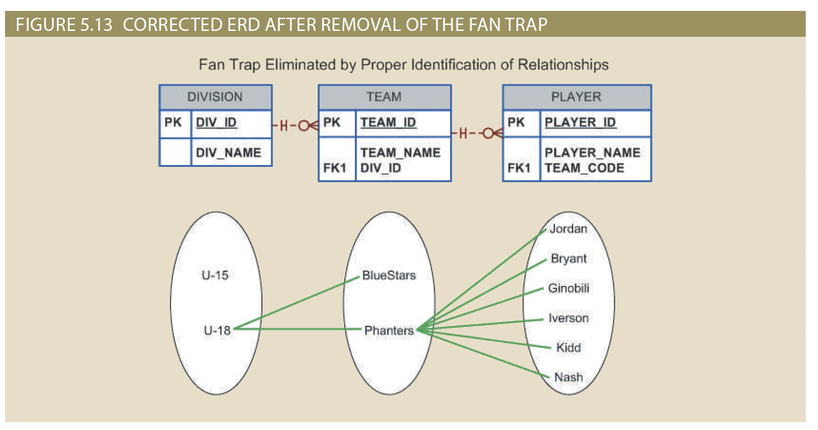

Slide 62
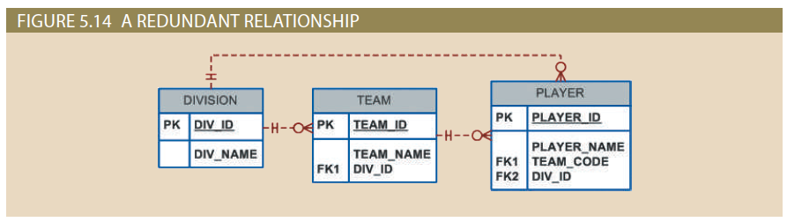
Redundant Relationships
When there are multiple relationship path between related entities, we say there is relationship redundancy.
Redundant relationships are sometimes used to simplify the design.
But sometimes there is no justification for the redundant relationships and it can be safely removed.

Slide 63
Maintaining History of Time-Variant Data
Time-Variant Data: data whose values change over time and for which you must keep a history of data changes.
The storage of time-variant data requires changes in the data model:
Sometimes keeping history means an attribute becomes multi-valued.
Sometimes, the necessity to maintain historic data converts a 1:M or 1:1 relationship to a M:N relationship!

Slide 64
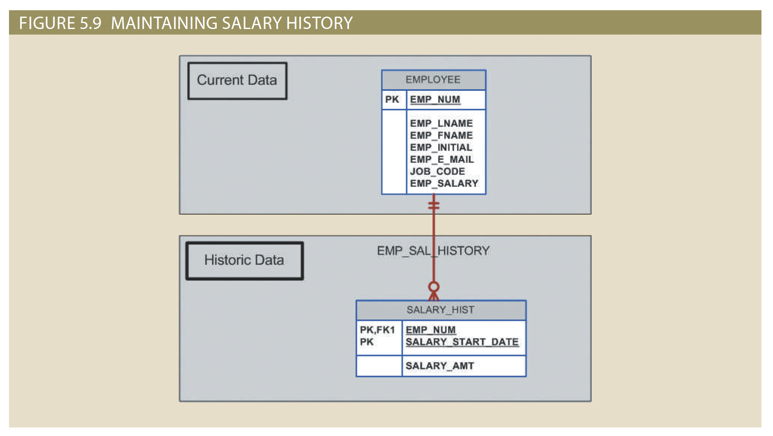
Maintaining History: Multi-Valued Attribute
Sometimes keeping history means an attribute becomes multi-valued. e.g. Employee Salary

Slide 65
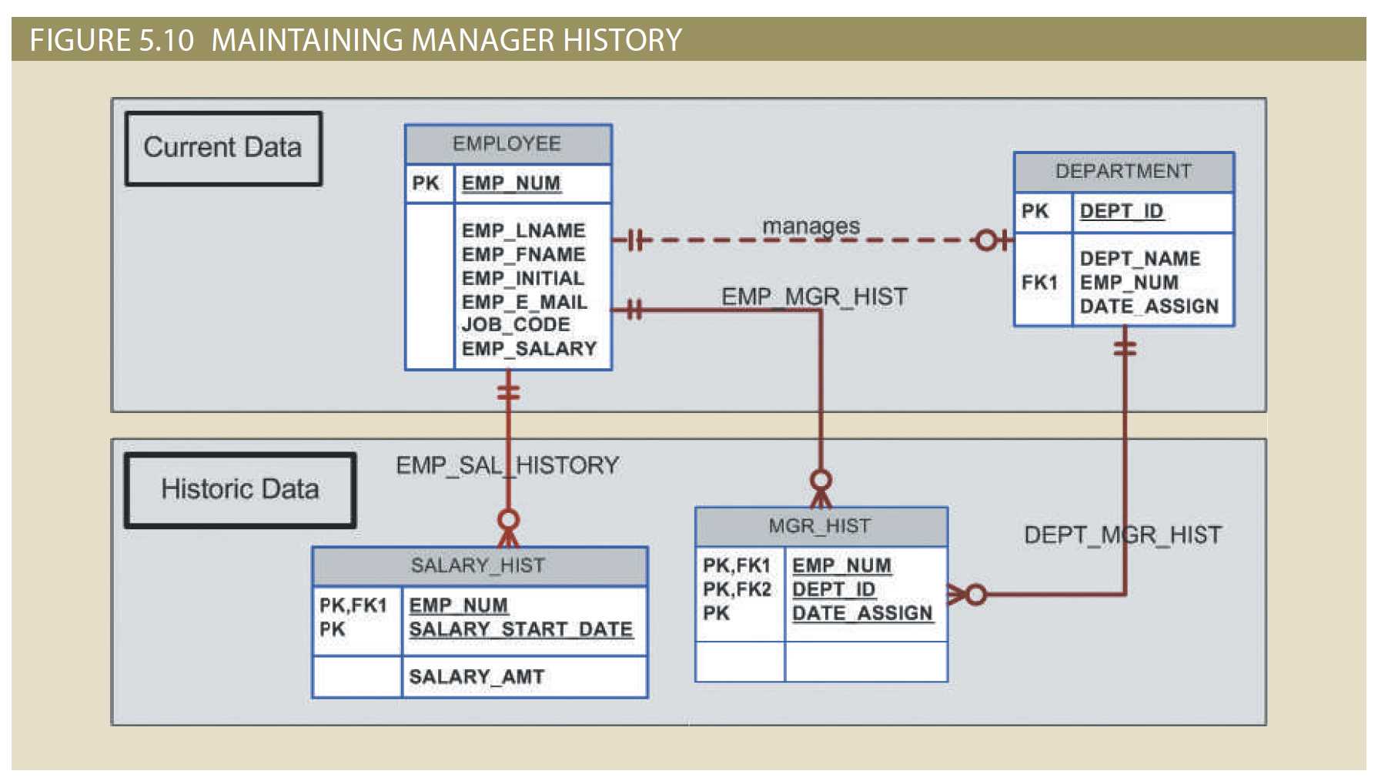
Maintaining History: M:N Relationship
Sometimes, the necessity to maintain historic data converts a 1:M or 1:1 relationship to a M:N relationship! e.g. EMPLOYEE manages DEPARTMENT.

Slide 66
Maintaining History: M:N Relationship
Sometimes, the necessity to maintain historic data converts a 1:M or 1:1 relationship to a M:N relationship! e.g. EMPLOYEE manages DEPARTMENT.
Notice that the “manages” relationship is still kept even though the current manager of a department can be queried from the MGR_HIST table. Why?

Slide 67
Takeaways & Next Steps
By the end of this module, you should be able to:
Map entities and attributes into relational tables and columns
Implement primary keys (natural, composite, surrogate) and enforce entity integrity
Implement foreign keys and enforce referential integrity
Map relationships into relational schemas:
1:M (FK on “many” side)
1:1 (design options for FK placement)
M:N (bridge/composite entities)
Recursive relationships
Handle existence dependence and strong relationships in schema design
Recognize and design for special cases: multi-valued attributes, time-variant data, fan traps, redundant relationships
Next Steps → Module 4
Refine relational schemas through functional dependencies
Apply normalization (1NF → BCNF) to ensure consistency and reduce redundancy

